Slide 1
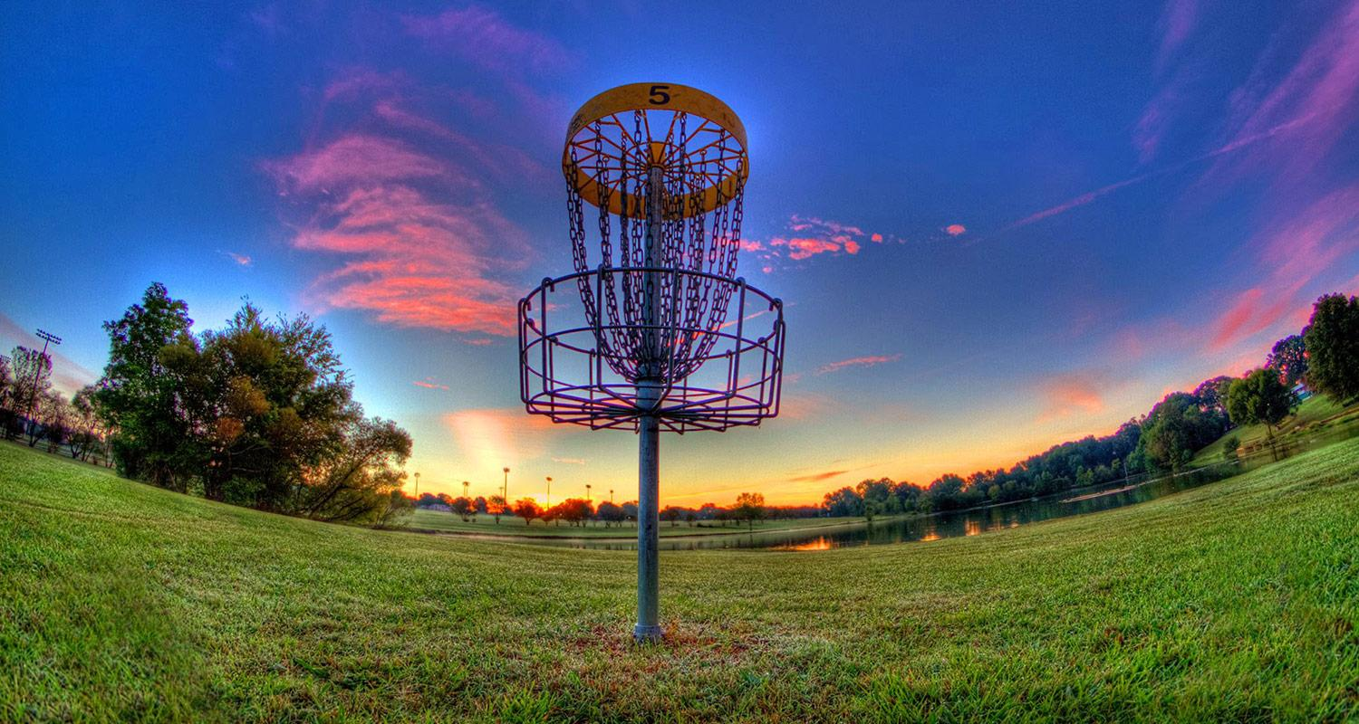
Welcome to the world of Disc Golf
Notes:
Hello and welcome to the world of Disc Golf. Thank you for meeting with me today. Let’s dive into what makes this such an exciting sport. First off, this sport is generally open to the public and does not require a membership, team, or even a legitimate course to be played. If you have a basket or for that matter a target of any sort and a disc you can play anywhere. This sport can be bought at the store and played anywhere. No inherent skill is needed to play either. It does not mater if you are playing for the first time or for the thousand time. We all hit trees two feet in front of us.

Slide 2
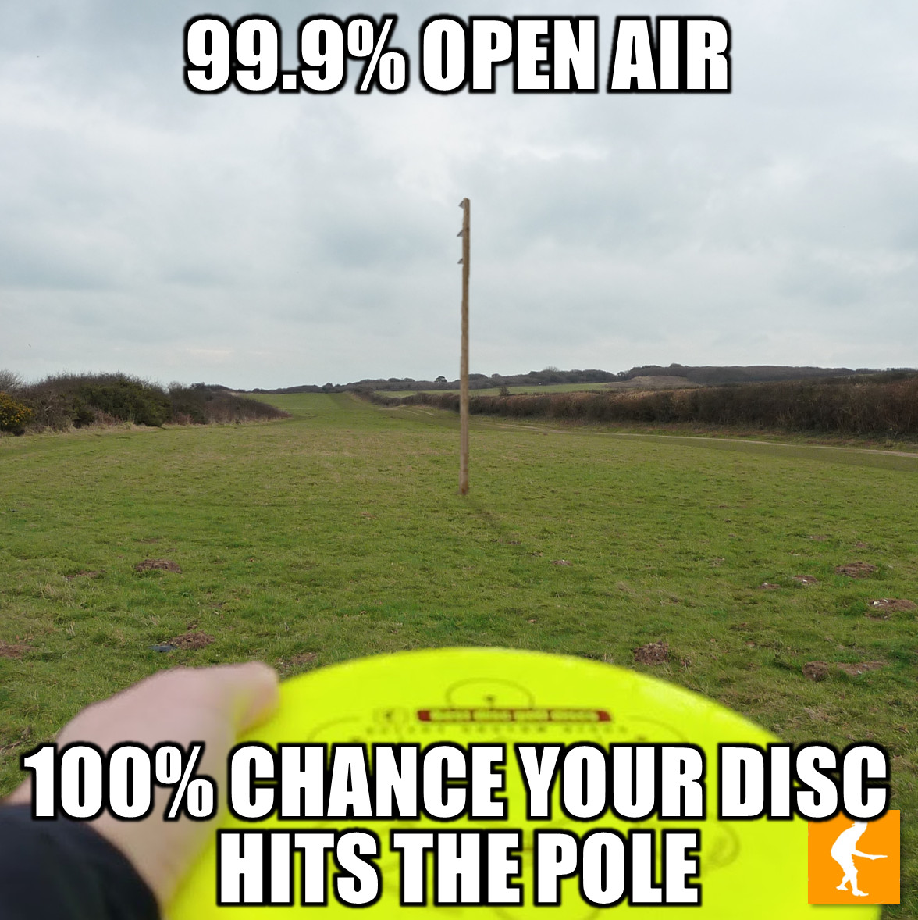
Interesting Facts:
Disk Golf was originally invented in the early 1900s and was originally called Tin Lid Golf. It was played by tossing tin lids into 4-foot wide circles drawn on the ground.
Ed Headrick a.k.a. (“Steady” Ed Headrick) was an inventor and is known as the father of both the modern day Frisbee and the sport and game of disc golf.
In 1977 Mr. Headrick with the help of his son Ken developed the modern basket for disc golf and they trademarked it “Disc Pole Hole”.
In 1993 Mr. Headrick was added to the Disc Golf Hall of Fame. His PDGA number is #1.
Currently there are over 187K registered players in the world between 80 different countries.
Across those 80 countries there are 9622 courses registered so far.
This link will take you to the official PDGA (Professional Disc Golf Assoc.) website to learn more or add a course that may not yet be known - Professional Disc Golf Association | (pdga.com).
Notes:
**** After making the notes about the registered players**** - Now I myself am not a registered player but one of the cool features of the PDGA is that it is an open platform, and anyone can submit info on existing or newly built courses. This means the data set is consistently updating.

Slide 3
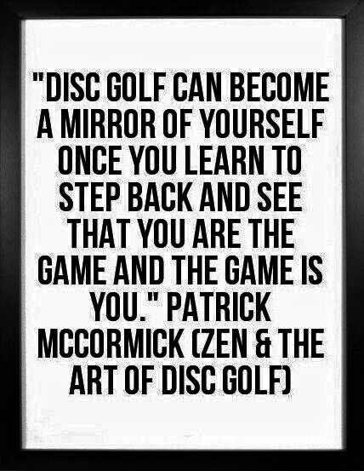
Objectives:
Create a user friendly dashboard to find Disc Golf courses in your local area as well as the United States as a whole.
Build a database to learn more about the course and location to be better prepared for your next adventure.
Help people know more about an amazing sport that is easy to learn, fun to play, and overall a great experience. Also a great way to unwind without spending a ton of money.

Slide 4

Dashboard:
An interactive dashboard built to make finding as well as knowing about your new (or old) favorite local disc course.
It can look at one or several states across the US and will give a satellite view of the surrounding area.
Using this tool can help you plan out your next trip and answer some looming questions we all have when visiting a disc golf park:
How big is the course?
Are there baskets in the woods?
Does it have any water holes?
Does it cost to enter?
Can I camp on the park grounds?
Most importantly - Does it have a bathroom?
All of this and more on the dashboard at - (Dashboard)

